Slide 1
Z-scores

Slide 3
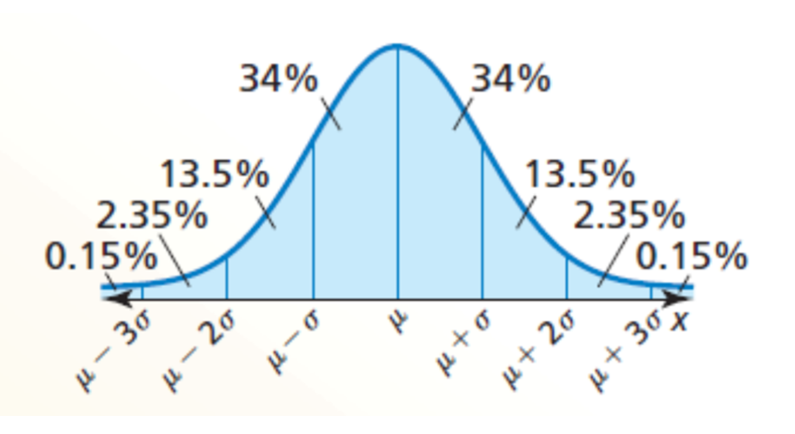
Say I had a distribution with a mean $μ=55$ and a standard deviation $σ=12$ …
How many standard deviations from the mean is the value $x=67$?
$$1$$
This number is called the z-score
How many standard deviations from the mean is the value $x=79$?
$$2$$
How many standard deviations from the mean is the value $x=73$?
$$1.5$$
How many standard deviations from the mean is the value $x=70$?
$$1.25$$

Slide 4
$$μ \left(lower case mu\right)=mean$$
$σ \left(lower case sigma\right)= standard deviation$

Slide 5
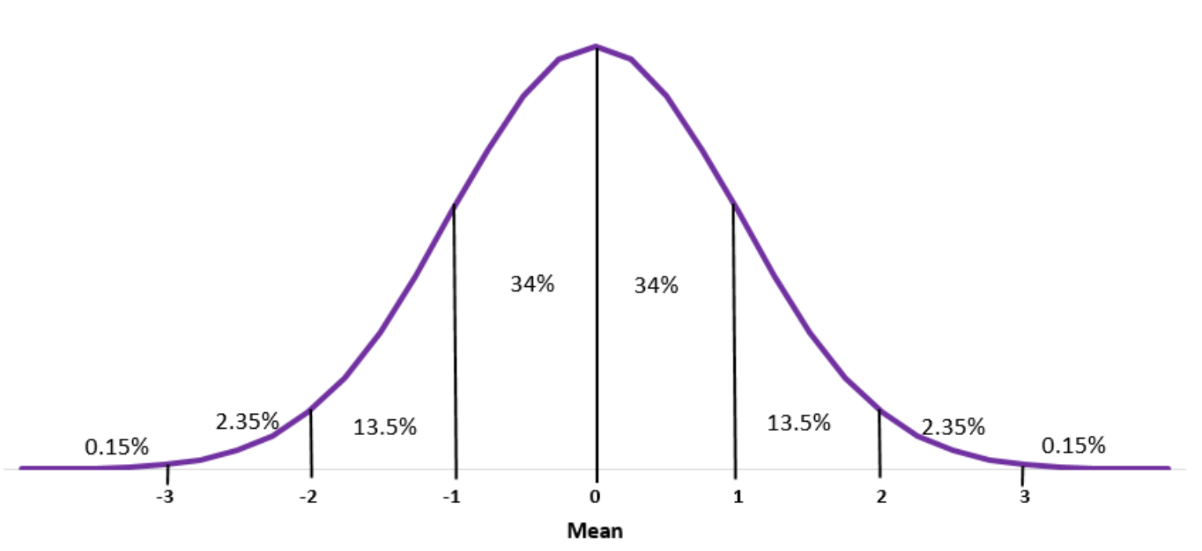
What is the z-score of a value of 27, given a sample mean of 24, and a standard deviation of 2?
SOLUTION
To find the z-score we need to divide the difference between the sample mean value, and the mean, 24, by the standard deviation, 2
$z=\frac{27−24}{2}=\frac{3}{2}$
This indicates that 27 is 1.5 standard deviations above the mean

Slide 6
On your own:
What is the z-score of a value, $x,$ of 104.5, in a population with a mean $μ=125$ and a standard deviation $σ=6.2$?
$z=\frac{\overline{x}−μ}{σ}=\frac{104.5−125}{6.2}=−3.306$
Note that the z-score is negative because $x=104.5$ is less than the mean $μ=125$.

Slide 7
Find the value $x$ represented by a z-score of 2.403, given $μ=63$and$σ=4.25$
Solution
This one requires that we solve for a missing value rather than for a missing z-score, so we just need to fill in our formula with what we know and solve for the missing value.
$z=\frac{x−μ}{σ}$
$2.403=\frac{x−63}{4.25}$
$10.213=x−63$
$73.213=x$
73.213 has a z-score of 2.403

Slide 8
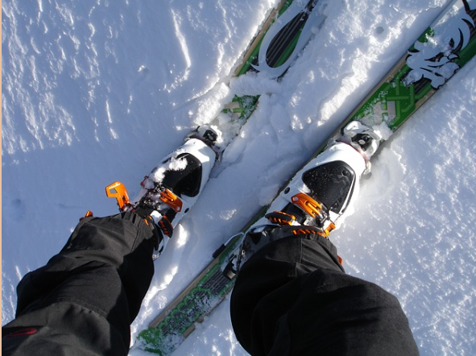
What is the z-score of the price of a pair of skis that cost $247, if the mean ski price is $279 with a standard deviation of $16?
$z=\frac{247−279}{16}=\frac{−32}{16}=−2$

Slide 9
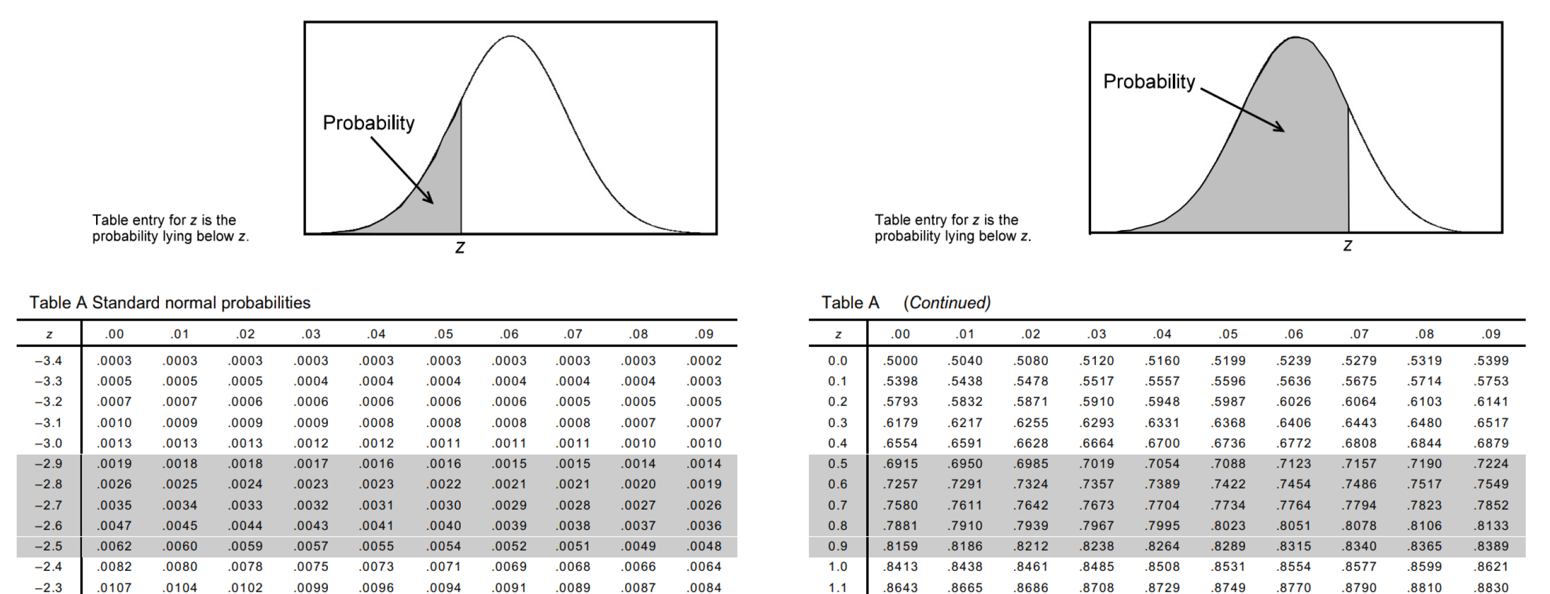

Slide 10
z-score = # of $σ$ from the $μ$
The Empirical Rule only provides probability percentages for INTEGER values of z-scores (standard deviations).
To find the value associated with a given z-score, find the first decimal (tenths place) for your z-score in the left column then the second decimal (hundredths place) across the top of the table. Where they intersect is the decimal expression of the % of values that are LESS THAN your sample.
To find the values for z-scores that aren’t integers we use a z-score table.

Slide 11
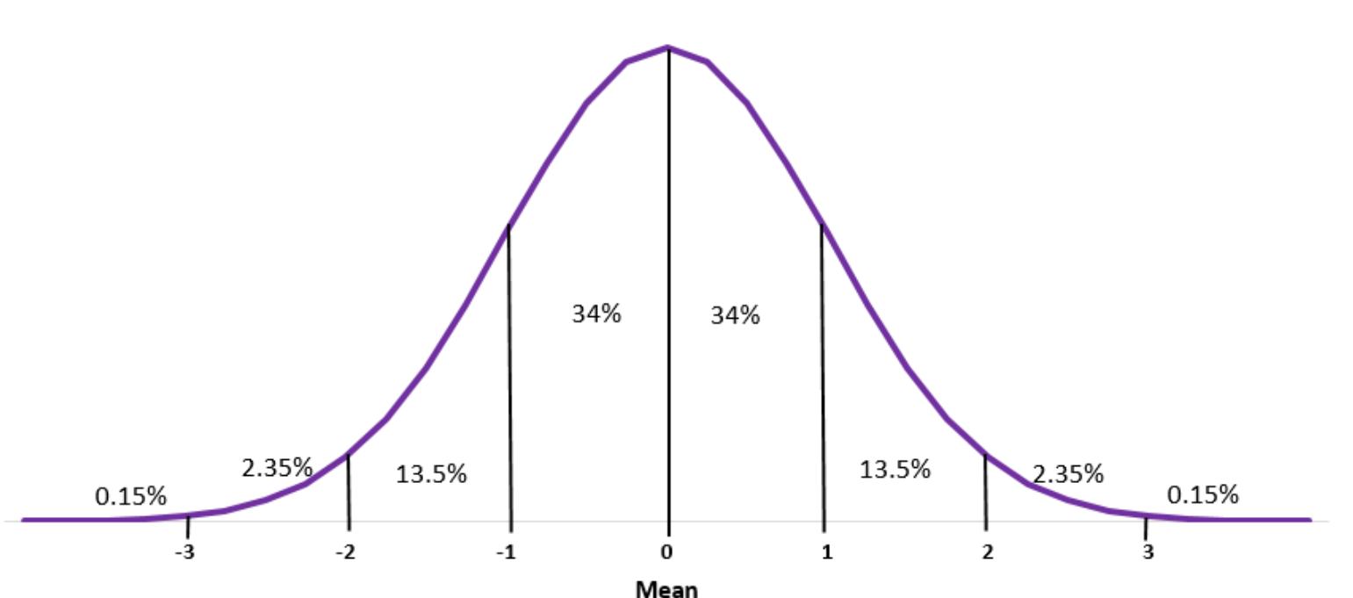
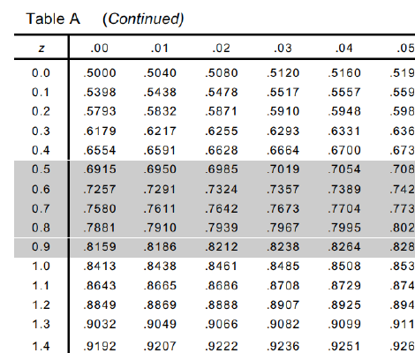
1. What is the probability of occurrence of a value with a z-score less than 1.24?
We use the value for z = 1.24 directly from the table, and just express it as a percentage: 0.8925 or 89.25%

Slide 12
2. What is the probability of $z > −0.23$?
We use the value for $z = −0.23$ from the table of 0.409. However, we want greater than $−0.23$ so we have to subtract from 1. $1 – 0.409 = 0.591 = 59.1\%$
…
REMEMBER: this gives us the probability of LESS THAN the z-score!

Slide 13
3. What is $P(z < 2.13)$?
…
Since this is a positive z-score, we can use the value for z = 2.13 directly from the table, and just express it as a percentage: 0.9834 or 98.34%

Slide 14
What is the probability associated with a z-score between 1.2 and 2.31?
SOLUTION
To evaluate the probability of a value occurring within a given range, you need to find the probability of both the upper and lower values in the range, and subtract to find the difference.
1.2
2.31

Slide 15
1.2
2.31
First find $z = 1.2$ on the z-table = 0.8849
Next, find $z = 2.31$ on the z-table = 0.9896
Since approximately 88.49% of all values are below z = 1.2 and approximately 98.96% of all values are below z = 2.31, there are $98.96\% − 88.49\% = 10.47\%$of values between.
The probability of getting a value between z = 1.2 and 2.31 is 10.47%

Slide 16
On your own: What is the probability that a value with a z-score between $−1.32$ and $1.49$ will occur in a normal distribution?
$$=P\left(z<1.49\right)−P(z<−1.32)$$
$$= .9319 − .0934$$
$$= .8385$$
$$= 83.85\%$$

Slide 17
Homework: See Teams for a worksheet

